Slide 1
Overloading
A method can be overloaded
Java matches a method call to a method definition with the
name
parameters: number, type, and order
This is called the signature of the method.
More than one method can have the same name in a class or package
Method signature can not be the same ie cannot have the exact same parameters
Example:
sleep()
sleep(int time)
sleep(boolean stop)
sleep(int start, int time)

Slide 2
Overloading Example
The Rectangle constructors are an example of overloading
Default constructor –
public Rectangle()
{
}
Alternate Constructor –
public Rectangle(double length, double width)
{
// initialise instance variables
setLength(length);
setWidth(width);
}

Slide 3
Another Overloading Example
Consider a Calculator class:
add()
This method would use attributes set in the constructor
add(double number1, double number2)
This method would use arguments passed to the method

Slide 4
Why Use Overloading?
Increases Readability
Increases Flexibility
Programmers can call the same method name with different types of data
Example: println(“Hi”), println(58), println(7.75)
We use println() to print all kinds of data
If println() wasn’t overloaded we would need many method names instead:
printString()
printInt()
printDouble()

Slide 5
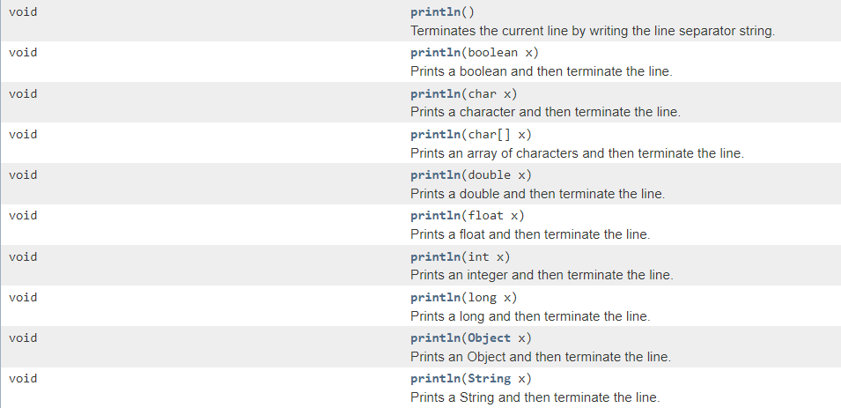
Overloaded println() method

Slide 6
Overloading
Here are some method headers..
A. public void print()
B. public void print(String name)
C. public void print(String date)
D. public void print(String name, int number)
If these were in the same class, which are valid examples of overloading?

